Slide 1

Introduction to C++
Session#1

Slide 2
Session’s Agenda
What is C++
Why Start With C++
How C++ works
Variables and Constants
Basic Data Types
Basic I/O
Operators
Comments
More Materials

Slide 3
What is C++
C++ is a cross-platform language that can be used to create high-performance applications.
C++ was developed by Bjarne Stroustrup, as an extension to the C language.
C++ is a low-level programming language that gives programmers a high level of control over system resources and memory.

Slide 4
Why Start With C++
Learn about computers and compilers
You’ll pick up other languages faster
C++ teaches you how to be a real, raw problem solver.

Slide 5
How C++ works
The Compiler
Compiling Phase
Object Files
Linking Phase

Slide 6
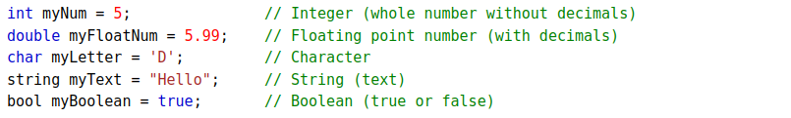
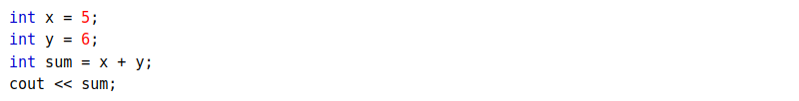
Variables, Literals and Constants

Slide 7
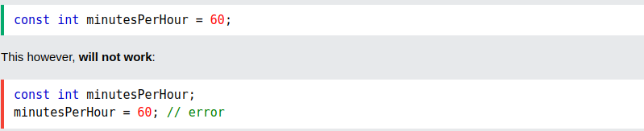
Variables, Literals and Constants

Slide 8
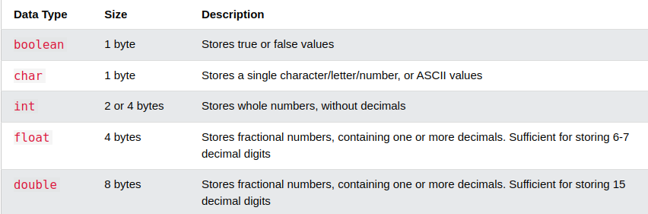
Basic Data Types

Slide 9
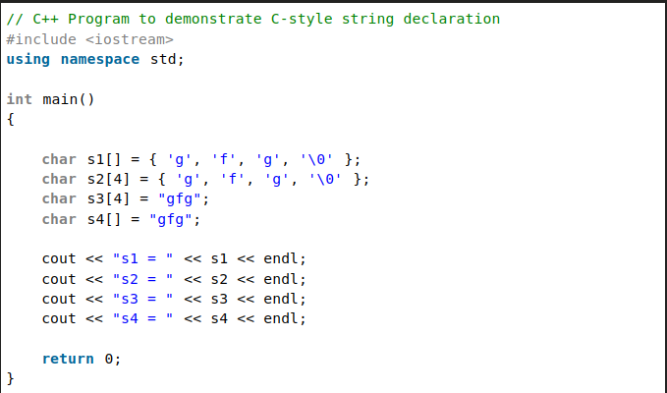
Basic Data Types

Slide 10
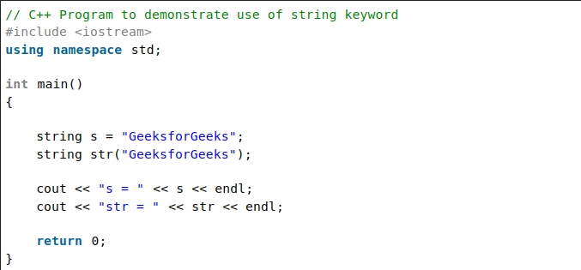
Basic Data Types

Slide 11
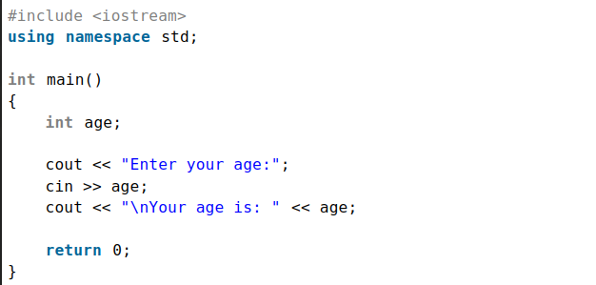
Basic I/O

Slide 12
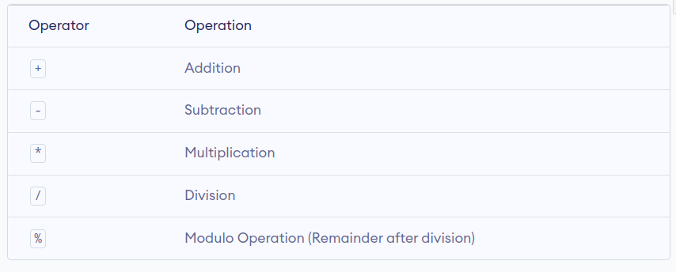
Operators

Slide 13
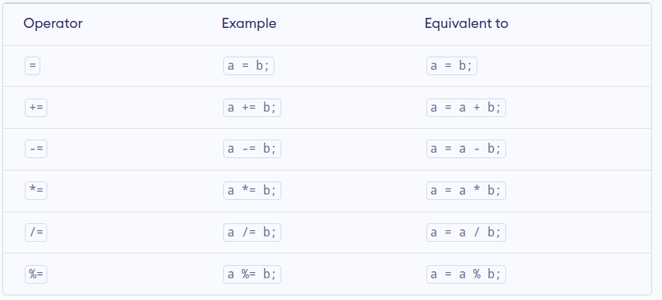
Operators

Slide 14
Comments
Comments can be used to explain C++ code, and to make it more readable. It can also be used to prevent execution when testing alternative code. Comments can be singled-lined or multi-lined.

Slide 15
More Materials
How C++ Works
C++ Variables
C++ Strings
C++ Operators

